Slide 1

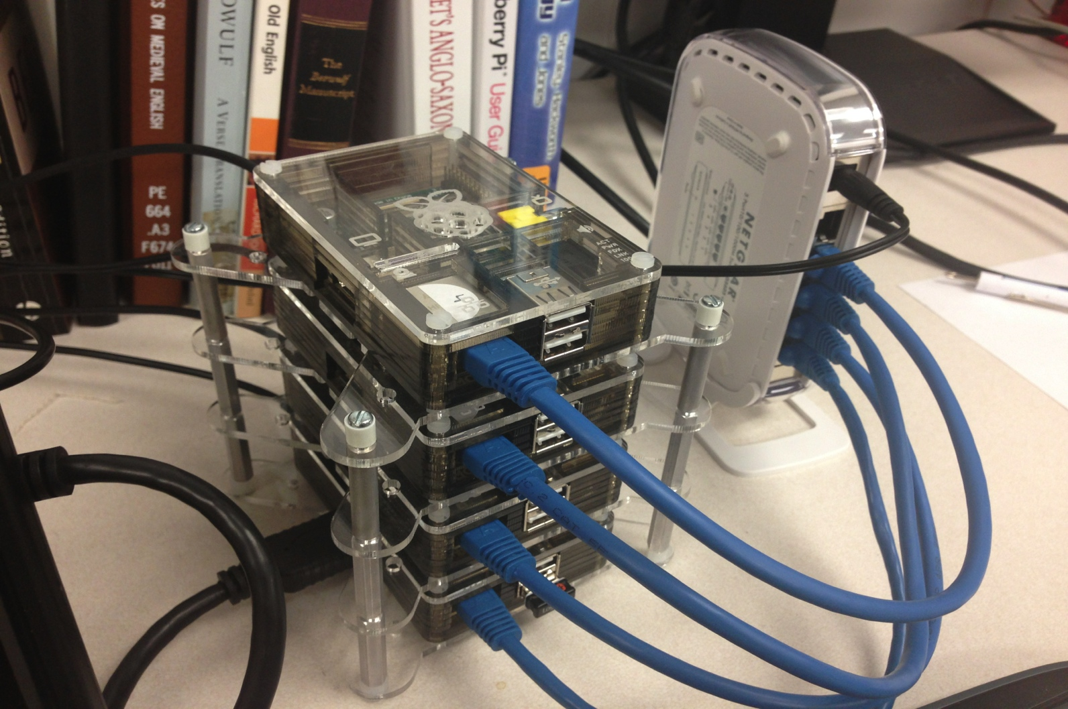
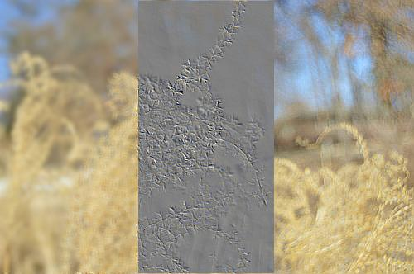
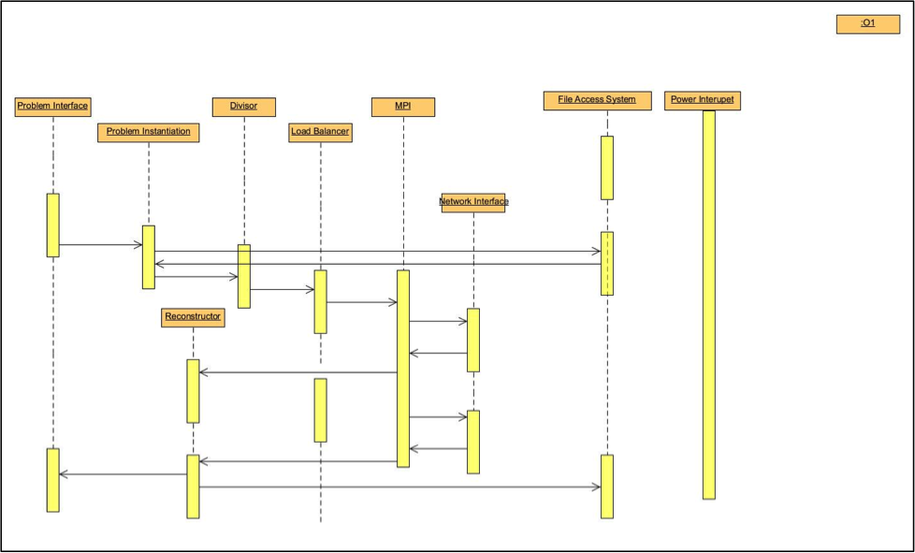
Raspberry Pi Cluster Image Processing
Brenna Blackwell, Nicolas Edwards, Joshua Ross
Computer Science and Computer Engineering Department
April 5, 2014
Completed Cluster with Switch
Image after manipulation with Python
Objective
To build a cluster computer system using inexpensive parts, such as Raspberry Pis and other peripherals, in order to create a more powerful computing and teaching tool.
Problem
Supercomputers are rare, expensive and inaccessible. Even if access to one is available, it is unlikely that users have authorization to modify configuration and other settings.
Architecture
Results and Analysis
Lowest average time per picture were achieved by . This confirms our thoughts that the MPI would allow for a more efficient handling of resources as data and commands were transferred between leafs and head node.
Average Time Per Picture
Divide and Conquer: 3.47s
Pipeline: 3.45s
Shell Script: 1.01s
Lessons Learned
Over the course of the project, we have gained familiarity with the architecture of a supercomputing cluster and writing programs capable of running on the required software environment. Additionally, we have gained an increase in familiarity with the Linux operating system and Python programming language.
Background
The Raspberry Pi Foundation’s goal for the system was to provide a small, inexpensive computer for children to learn about computer science. Our work expands on that goal by focusing on distributed computing.
Interface Design
The hardware-based user interface of the Raspberry Pi cluster is the same as that of a standard home computer – monitor, mouse, keyboard, etc. The operating system used is Raspian, a distro of Debian optimized for the Raspberry Pi device, and is easy to use even for those without prior Linux experience.
Potential Impact
Due to the inexpensive nature of Raspberry Pis, this project has the potential to allow more students access to a computer with structural similarity to a supercomputer to experiment on a distributed system.
Deliverables
4-Node Cluster Prototype
GitHub Repository featuring all test code and source code
Final Report about the project
Requirements
At least two Raspberry Pis
Ethernet Switch or Router
Other Desired Peripherals
Implementation
The four Pis are networked together by way of an ethernet switch. The operation system used is Raspian, and the Pis communication by way of custom shell scripts and the OpenMPI message passing software.
Future Work
Investigate centralized USB accessible data is needed to limit contention for the head nodes resources. Increased logging is needed to get more concrete data sets to analyze performance and identify bottlenecks. Integration of administrative shell scripts with python algorithms will allow for a more configurable and user definable cluster, so as to open the cluster up to end user algorithm design and implementation.
Key Personnel
Brenna Blackwell is a senior Computer Engineering major at the University of Arkansas.
Nicolas Edwards is a senior Computer Engineering major at the University of Arkansas.
Joshua Ross is a senior Computer Science major at the University of Arkansas.

